Slide 1
Implementing
C3PR at UAMS
Gail Douglas
C3PR Face to Face Meeting
March 25 - 26, 2010

Slide 2
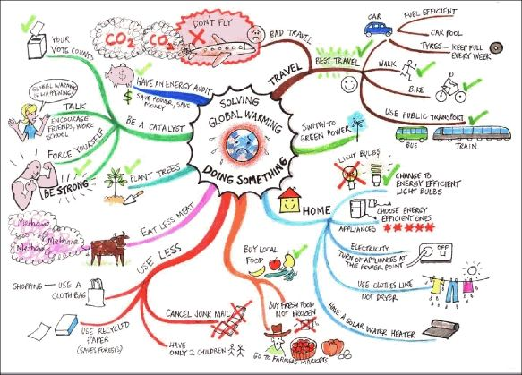
Where We Started
Budgets were not prepared in a standard format, fees were
inconsistent, approvals were not documented, billing compliance
difficult to track: Chaos!!

Slide 3
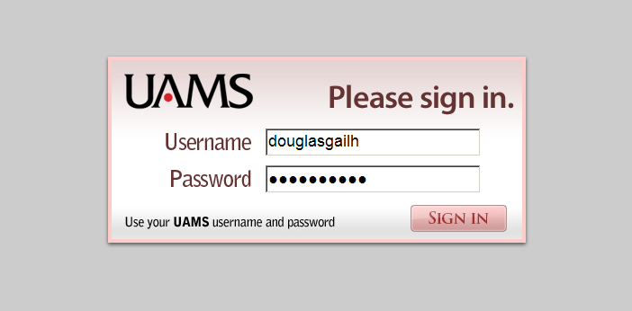
UAMS Single Sign-On to CTMS Suite
Authenticate on the Domain Username and Password
Future enhancement to provide secure access by outside users

Slide 4
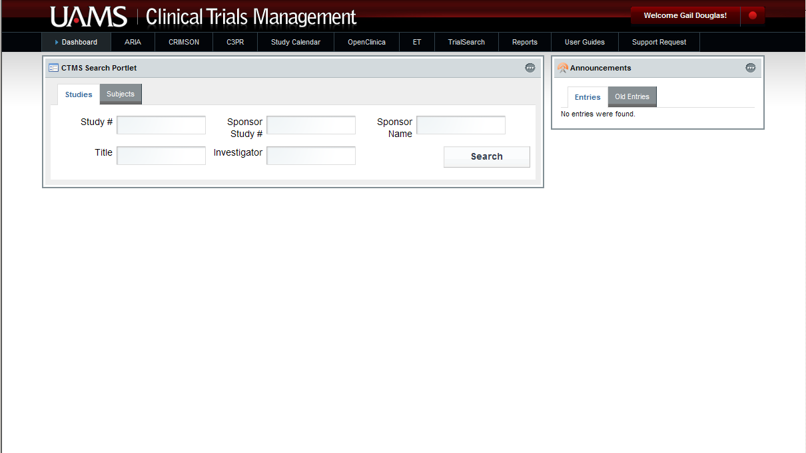
UAMS Clinical Trials Dashboard
A Study’s Life Cycle at UAMS by Application
ARIA – Enter protocol information for IRB submission
CRIMSON – Detailed budget – budget approval
ET – EventTracker – Track study submission / approval
C3PR – Register subject
Study Calendar – Follow subject progression through the research study
OpenClinica – Capture subject study data

Slide 5
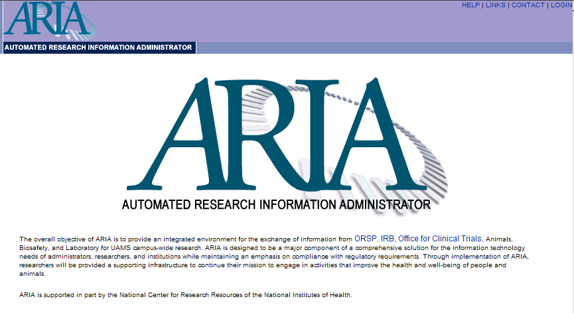
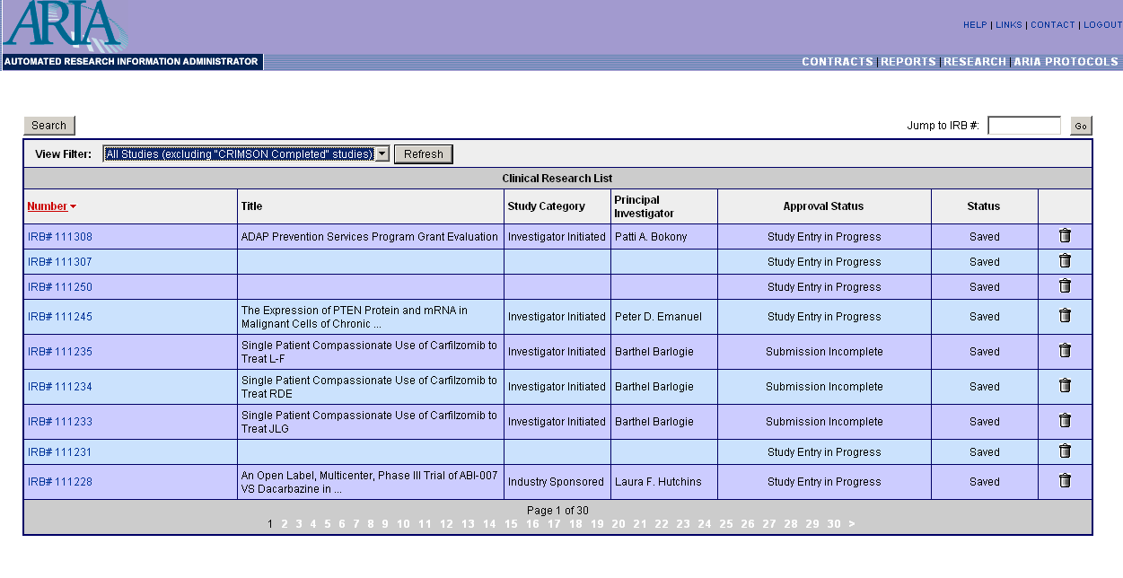
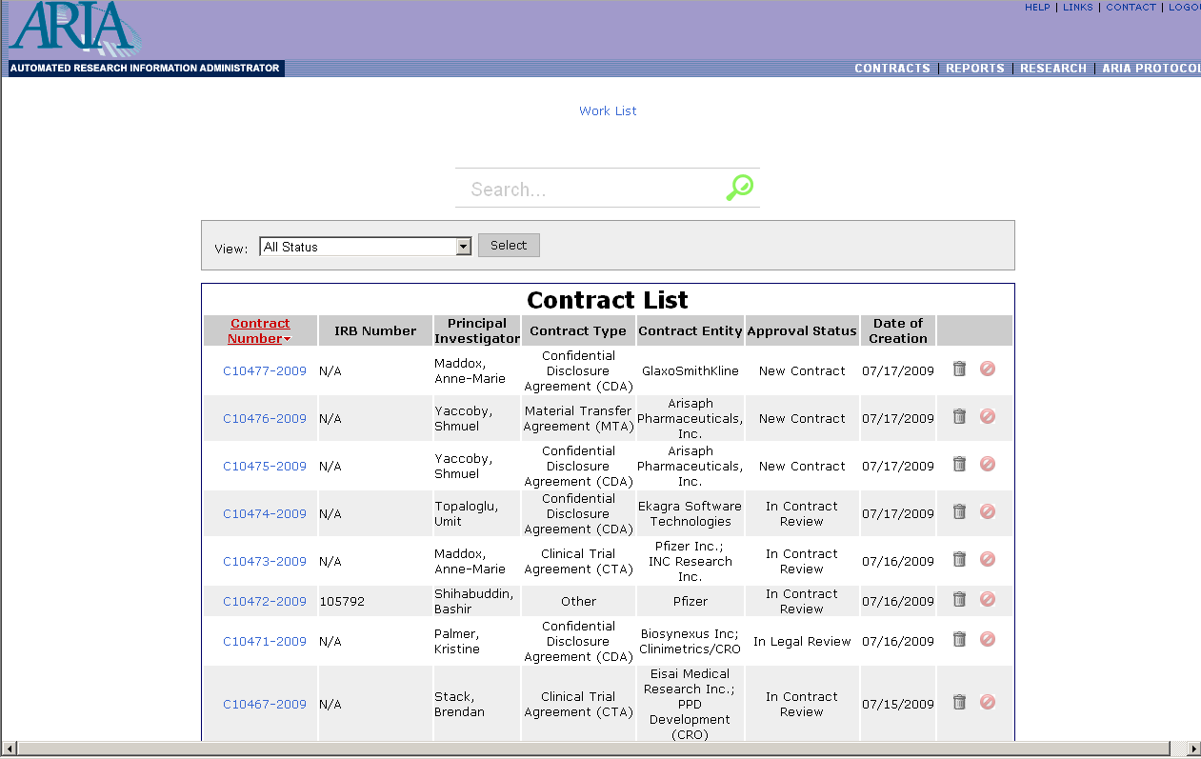

UAMS ARIA, CRIMSON, & Contracts
Protocol and Grant Admin
CRIMSON Protocol Budget
Research Contracts

Slide 6
C3PR- Local Changes
  fixed some bugs
  added (reintroduced) waivers for patients who fail eligibility
  added Consent Form history
  added details to amendment review page
  added data fields (SSN)
  added CRIMSON / ET view in Study Summary page
  implemented importing subject from UAMS registration system

Slide 7
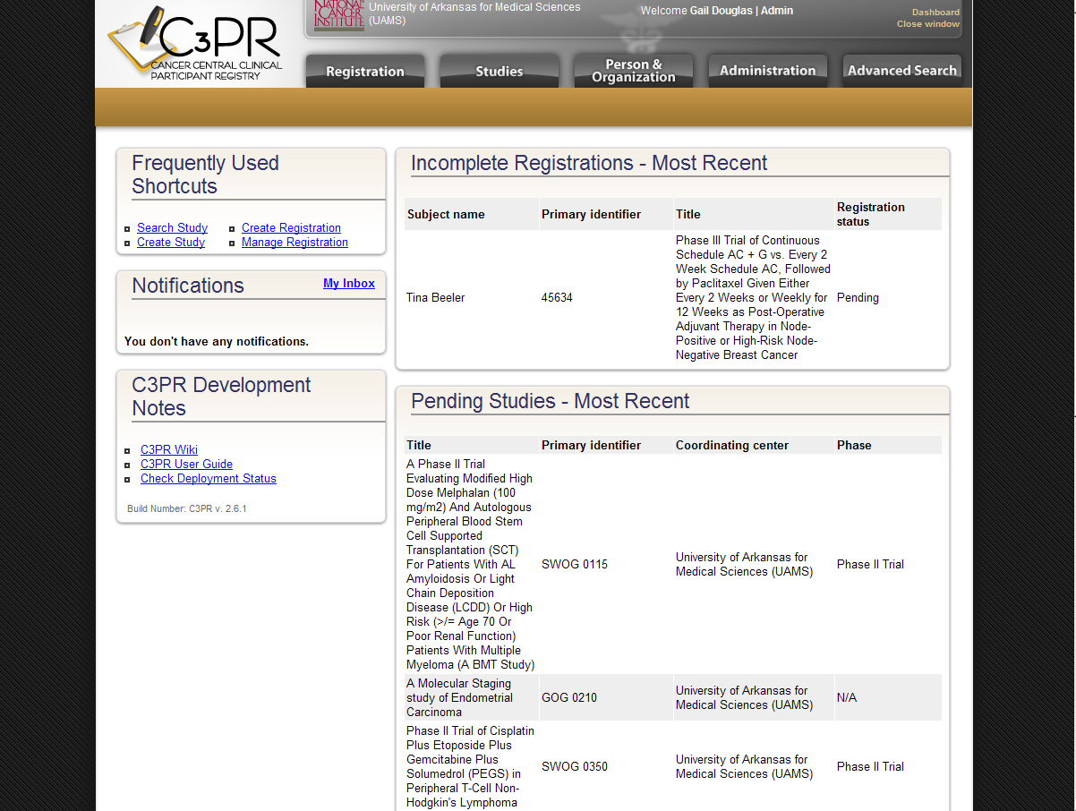
caBIG Cancer Central Clinical
Participant Registry- v2.6

Slide 8
C3PR- Wish List
C3PR- Wish List
‘Search by Name’ feature needs to allow more than one search parameter to be
entered to differentiate persons with the same name, e.g., Smith
Blind studies- why require two arms to be entered? (When Blind is selected, the
system automatically selects Random)

Slide 9
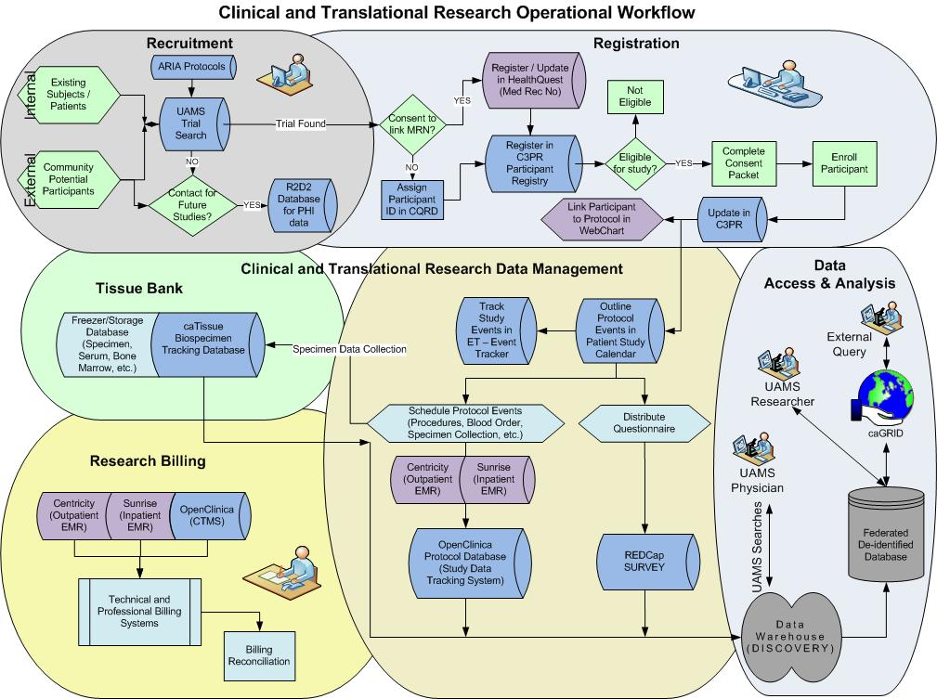
Where We Want to Be

